Slide 1




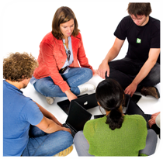

.
Qt in Education
The
Graphics View
Canvas
Notes:
This lecture introduces the graphics view classes – view, scene and various items.
The concepts are introduced and basic interaction techniques are discussed. The final slides of the lecture are devoted to performance improvements.
Recommended reading before the lecture:
http://doc.trolltech.com/4.6/graphicsview.html

Slide 2


© 2011 Nokia Corporation and its Subsidiary(-ies).
The enclosed Qt Materials are provided under the Creative Commons
Attribution-Share Alike 2.5 License Agreement.
The full license text is available here:
http://creativecommons.org/licenses/by-sa/2.5/legalcode.
Nokia, Qt and the Nokia and Qt logos are the registered trademarks
of Nokia Corporation in Finland and other countries worldwide.

Slide 3

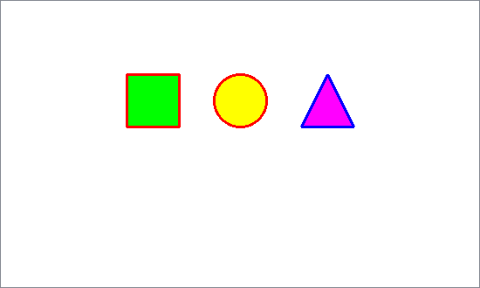
The Graphics View Framework
The Graphics View Frameworks is a scene based approach to graphics
QGraphicsScene
QGraphicsItem
QGraphicsView
Notes:
The graphics view framework is based on a scene of items. The scene can then be shown through a view.
This concept differs from plain custom widgets in that you do not have to re-implement a paint event. Instead, the graphics view, scene and items collaborate on optimizing repainting.
Of course, there is a paint event in the system, and each item knows how to draw itself, but you do not have to explicitly use a QPainter for every update to the screen.
Continues

Slide 4
Item scenes compared to widgets
Widget | Scene / Items
Rectangular | Arbitrary shape
Non-overlapping (when in layouts) | Arbitrary position
Optimized for a native platform look | Optimized for animations and effects
Integer (pixel) coordinates | Floating point (sub-pixel) coordinates
Notes:
Other differences between widgets and the scene/item approach is:
Widgets are always rectangular, while items can have any shape
Widgets do not overlap, while scene items can
Widgets update when update is called, scene items update when needed (optimization)
Widgets try to integrate with the native platform's look and feel, scene items focus on animations and effects
Widgets use integer pixel coordinates, scene items uses floating point, sub-pixel, coordinates
Continues

Slide 5
Painting Using
QWidget and paintEvent
void Widget::paintEvent(QPaintEvent *)
{
QPainter painter(this);
painter.setPen(QPen(Qt::red, 3));
painter.setBrush(Qt::green);
painter.drawRect(20, 20, 60, 60);
...
}
What about supporting more items?
What about moving items about?
Notes:
Think about implementing the shown view as a QWidget.
You could have to create a paint event that draws the shapes.
What about adding more items? moving the items about?
Continues

Slide 6
Painting Using
Graphics View
void Widget::setupScene()
{
QGraphicsView *view = new QGraphicsView();
QGraphicsScene *scene = new QGraphicsScene(0, 0, 300, 200, this);
scene->addRect(20, 20, 60, 60, QPen(Qt::red, 3), QBrush(Qt::green));
scene->addEllipse(120, 20, 60, 60, QPen(Qt::red, 3), QBrush(Qt::yellow));
scene->addPolygon(QPolygonF() << QPointF(220, 80) << QPointF(280, 80)
<< QPointF(250, 20), QPen(Qt::blue, 3), QBrush(Qt::magenta));
view->setScene(scene);
view->show();
}
Notes:
The graphics view based approach does not define a paint event, instead a view and scene are created.
The shapes are added to the scene
The scene is set for the view
The view is shown
Adding more shapes is just a matter of adding more shapes
Moving the shapes around is up to the scene

Slide 7
The Scene
The QGraphicsScene class contains all items and acts as an interface between the view and the items
  Owns all items
  Distributes paint events
  Distributes other events
  Provides methods for locating items
    itemAt – the top item at a given location
    items – all items in a given area
Notes:
The QGraphicsScene class holds the entire scene and acts as the interface between the items in the sceen and the view.
Its job is to own all the items
Distributes paint events to items
Distributes other events such as clicks
Provides methods for working with items
itemAt, the top item for coordinate
items, all items in a given area
Continues

Slide 8
Initializing a Scene
Each scene has a sceneRect defining the extent of the scene
  If it is not specified, it will be the largest rectangle containing (or having contained) the scene items
QGraphicsScene *scene = new QGraphicsScene(this);
scene->setSceneRect(-100, -100, 201, 201);
The rectangle does not have
to start at the origin (0, 0)
Notes:
When creating a scene, it is common to specify a scene rectangle.
This rectangle defines the extent of the scene.
If the scene rectangle is not specified, Qt will calculate it from the largest rectangle that is (or ever has) contained an item.
This means that the scene rectangle will expand as items are added or moved.
Notice that the scene rect does not have to start at the origin, (0,0). It can have any extent.
Continues

Slide 9
Populating a Scene
The QGraphicsScene class makes it easy to add basic shapes to a scene
Supports ellipses, lines, painter paths, pixmaps, polygons, rectangles and text
  Each item type is represented by a separate class derived from QGraphicsItem
QGraphicsItem *item =
scene->addRect(20, 20, 60, 60,
QPen(Qt::red, 3), QBrush(Qt::green));
Notes:
When the scene has been created and setup, it is time to add items to it.
Ellipses, lines, complex paths, pixmaps, polygons, rectangles and text can be added using the addNnn methods of the scene.
Each item added is represented by a QGraphicsItem derived object.
Continues

Slide 10
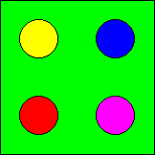
Populating a Scene
For custom items and complex cases, it is possible to create items and then add them to a scene
QGraphicsRectItem *rootItem =
new QGraphicsRectItem(-50, -50, 101, 101);
rootItem->setBrush(Qt::green);
QGraphicsEllipseItem *item;
item = new QGraphicsEllipseItem(-40, -40, 30, 30, rootItem);
item->setBrush(Qt::yellow);
item = new QGraphicsEllipseItem( 10, -40, 30, 30, rootItem);
item->setBrush(Qt::blue);
item = new QGraphicsEllipseItem(-40, 10, 30, 30, rootItem);
item->setBrush(Qt::red);
item = new QGraphicsEllipseItem( 10, 10, 30, 30, rootItem);
item->setBrush(Qt::magenta);
scene->addItem(rootItem);
QGraphicsItems can
be placed in an
object hierarchy
Notes:
For more complex cases, it is possible to create items first and then add them to the scene.
In the example above, the rootItem is a green rectangle item (QGraphicsRectItem)
All the circles are implemented by QGraphicsEllipseItem instances.
The items are then placed in a hierarchy, so that the circles are placed inside the root item.
Continues

Slide 11
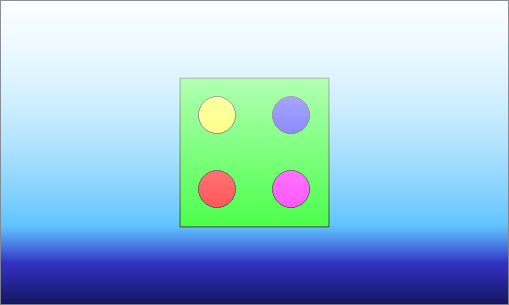
Background and Foreground
It is possible to set both foreground and background brushes for a scene or view
Sub-class the view and reimplement drawBackground and drawForeground for custom painting
scene->setForegroundBrush(hazeBrush);
scene->setBackgroundBrush(blueToBlackBrush);
Notes:
Finally, to tweak the scene, it is possible to set both foreground and background brushes.
Using gradient brushes and transparency, effects such as fog or fade in/fade out can be implemented.
To do custom background painting, i.e. not just a brush, you can sub-class the view and re-implement the drawBackground and drawForeground methods.
Continues

Slide 12
Setting up a view to a scene
The QGraphicsView widget serves as the viewport in which the scene is shown
By default, the scene is centered. Use the alignment property to control this
The view class is derived from QAbstractScrollArea. From this class the horizontalScrollBarPolicy and verticalScrollBarPolicy properties are inherited
QGraphicsView *view = new QGraphicsView();
QGraphicsScene *scene = setupScene();
view->setScene(scene);
Notes:
When you have created a scene, you must provide a view
In most scenarios, the QGraphicsView class can be used as it is.
By default, the scene is centered. You can control this using the alignment property
As the view is derived from a scroll area, you must take action to prevent scrollbars from being shown when the scene does not fit into the view

Slide 13
Basic Transformations
Both the QGraphicsItem class and the QGraphicsView class can be transformed
  scaling
  translating
  rotating
  shearing
  2.5D effects
Notes:
Both items and the view itself can be transformed.
All the available transformations can be applied:
scaling
translating
rotating
shearing
as well as 2.5D effects, i.e. fake 3D effects
Continues

Slide 14
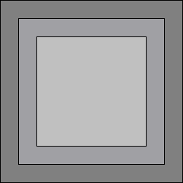
Nested Transformations
When transforming parent items, the children are also transformed
QGraphicsRectItem *rootItem = new QGraphicsRectItem(...);
rootItem->setBrush(Qt::darkGray);
QGraphicsRectItem *midItem = new QGraphicsRectItem(..., rootItem);
midItem->setBrush(Qt::gray);
QGraphicsRectItem *topItem = new QGraphicsRectItem(..., midItem);
topItem->setBrush(Qt::lightGray);
Notes:
When items are placed in an hierarchy, the parent's transformation is propagated to the children.
In the figure, you can see three items: rootItem, midItem, topItem. They are declared in the code here, and the result is shown in the figure in the top right corner.
Continues

Slide 15
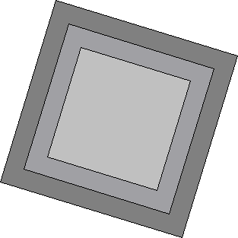
Nested Transformations
When transforming parent items, the children are also transformed
QGraphicsRectItem *rootItem = new QGraphicsRectItem(...);
rootItem->setBrush(Qt::darkGray);
rootItem->setRotation(17);
QGraphicsRectItem *midItem = new QGraphicsRectItem(..., rootItem);
midItem->setBrush(Qt::gray);
QGraphicsRectItem *topItem = new QGraphicsRectItem(..., midItem);
topItem->setBrush(Qt::lightGray);
Notes:
Rotating the root item, rotates all items
Continues

Slide 16
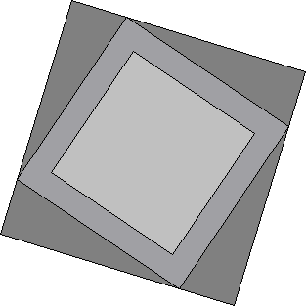
Nested Transformations
When transforming parent items, the children are also transformed
QGraphicsRectItem *rootItem = new QGraphicsRectItem(...);
rootItem->setBrush(Qt::darkGray);
rootItem->setRotation(17);
QGraphicsRectItem *midItem = new QGraphicsRectItem(..., rootItem);
midItem->setBrush(Qt::gray);
midItem->setRotation(17);
QGraphicsRectItem *topItem = new QGraphicsRectItem(..., midItem);
topItem->setBrush(Qt::lightGray);
Notes:
Rotating the mid item, rotates it too.
Notice that the root item transformation still is applied
Continues

Slide 17
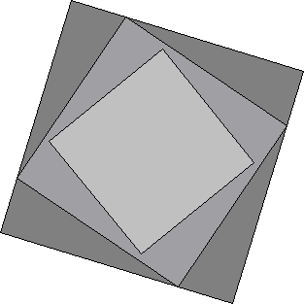
Nested Transformations
When transforming parent items, the children are also transformed
QGraphicsRectItem *rootItem = new QGraphicsRectItem(...);
rootItem->setBrush(Qt::darkGray);
rootItem->setRotation(17);
QGraphicsRectItem *midItem = new QGraphicsRectItem(..., rootItem);
midItem->setBrush(Qt::gray);
midItem->setRotation(17);
QGraphicsRectItem *topItem = new QGraphicsRectItem(..., midItem);
topItem->setBrush(Qt::lightGray);
topItem->setRotation(17);
Notes:
Finally, the top item can be transformed as well

Slide 18
Coordinate systems
The view, scene and each item has a local coordinate system
  The view can
    mapFromScene / mapToScene
  The items can
    mapFromScene / mapToScene
    mapFromParent / mapToParent
    mapFromItem / mapToItem
  The scene always uses its own coordinate system
Notes:
When we looked at transformations, we saw that each item lives in the coordinate system of its parent
In addition to each item having a coordinate system of its own, so does the scene and the view
The view can map from and to scene coordinates using mapFrom/ToScene
Items can also map from and to scene coordinates using mapFrom/ToScene
They can also map from and to their parent's coordinates using mapFrom/ToParent
as well as to an arbitrary widget using mapFrom/ToItem
The scene, however, does not convert from or to any coordinate systems. It always relies on scene coordinates.

Slide 19
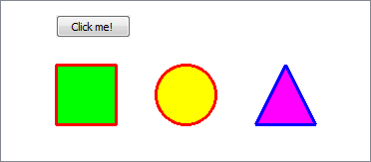
Embedding widgets
It is possible to add widgets to a scene
QGraphicsScene::addWidget returns a QGraphicsProxyWidget – a wrapper for the widget in the scene
This is a convenience solution and not a high performance option
QGraphicsProxyWidget *button = scene->addWidget(
new QPushButton(tr("Click me!")));
button->setPos(20, -30);
Notes:
It is possible to mix graphics items and widgets in a scene.
The scene's addWidget method returns a QGraphicsProxyWidget, which is an item that holds the widget.
Embedding widgets can seem like a good way to add functionality to a scene, but the solution is provided more as a convenience.
Embedding widgets is a slow solution.

Slide 20
Adding Interaction
The flags of the items control how they can be interacted with
  ItemIsMovable – a convenience feature, the original mouse event methods let the user drag the item
  ItemIsSelectable – the item can be selected using setSelected and the QGraphicsScene::setSelectionArea method
  ItemIsFocusable – the item can receive keyboard focus
Notes:
The graphics view classes are designed to be a good platform for interactive scenes
This means that making items movable is dead easy, just as making them selectable or focusable
A movable item lets the user move the item about by dragging it
Items have a selected property built in. Using the setSelected or setSelectionArea methods, items can be selected.
Focusable items can receive keyboard focus, and thus key events.
Continues

Slide 21
Moving Items
By setting the ItemIsMovable flag, items can be moved around using the mouse
When an item is moved, the item receives ItemPositionChange events
Using an event filter it is possible to trace movements in the standard items without sub-classing
QGraphicsItem *item;
item = scene->addRect(...);
item->setFlag(QGraphicsItem::ItemIsMovable, true);
Notes:
Using the setFlag method of an item, you can set the ItemIsMovable flag. By doing so, the item can be moved around by the user using the mouse.
When the item is moved, it receives ItemPositionChange events
If you want to trace the movements of standard items without sub-classing them, you can use an event filter to intercept the ItemPositionChange events

Slide 22
Sub-classing Items
When sub-classing items, there are numerous events that can be intercepted
  hoverEnter / hoverMove / hoverLeave
  itemChange (move, transform, selection, etc)
  keyPress / keyRelease
  mousePress / mouseMove / mouseRelease
  etc
It is also possible to implement the sceneEventFilter method and install the item as an event filter on selected items
Notes:
When sub-classing items to create custom items, there is a whole set of events that can be acted upon.
hoverEnter/Move/Leave – for tracking a hovering mouse pointer (i.e. no pressed buttons)
itemChange – reports movements, selections, transformations, etc
keyPress/Release – keyboard interaction
mousePress/Move/Release – mouse interaction
Using a sceneEventFilter, you can filter for these events without sub-classing the items themselves.

Slide 23
Optimizing itemAt tests
QGraphicsScene::itemAt is frequently called when the user interacts with a scene
  Relies on a BSP tree of all the items for performance reasons
When items are moved, the BSP tree is updated
  In a scene with lots of movements, updating the BSP tree can be heavier than using a less efficient itemAt
Using the scene's bspTreeDepth and itemIndexMethod properties, the BSP tree can be tuned or disabled
Notes:
One of the most frequently used functions when interacting with scenes is the itemAt method
For instance, when hovering over a scene, every single mouse movement causes a call to the method
The scene relies on a BSP (binary space partition) tree to answer itemAt questions quickly
When items are moved, the BSP tree is updated
Updating the tree in a scene with lots of movement can be heaver than what you gain from itemAt
By turning the bspTreeDepth and itemIndexMethod properties, you can disable or limit the size of the BSP tree, thus tuning performance

Slide 24
What is a BSP tree
Binary Space Partitioning trees store items in a tree, depending on their location in space
1
2
3
4
Notes:
A BSP tree, binary space partitioning tree, stores items in a tree. Each item's location in the tree depends on its relative location to its parent.
Taking the scene here, with the items 1 through 4, we can create a simple BSP tree.
Continues

Slide 25
What is a BSP tree
Binary Space Partitioning trees store items in a tree, depending on their location in space
1
1
2
left
right
3
4
Notes:
Starting from our root item, 1, we place all other items either to the left or to the right. In this case, all items are to the right.
Continues

Slide 26
What is a BSP tree
Binary Space Partitioning trees store items in a tree, depending on their location in space
1
1
2
left
right
2
3
4
left
right
Notes:
Here, item number two is picked and placed to the right of 1.
The remaining items are again split into left and right, depending on their location in relation to item 2.
Continues

Slide 27
What is a BSP tree
Binary Space Partitioning trees store items in a tree, depending on their location in space
1
1
2
left
right
2
3
4
left
right
3
4
left
right
left
right
Notes:
This places items 3 and 4 into the tree.
This type of tree can be used to improve collision detection times as well as repainting times. However, they are also costly to construct.

Slide 28
Tuning view update regions
To optimize performance for scene updates, Qt tries to repaint smartly
The view's viewportUpdateMode controls how the repainting is done
  FullViewportUpdate – the entire view is updated on all changes
  MinimalViewportUpdate – only a minimal update is requested
  SmartViewportUpdate – Qt tries to optimize
  BoundingRectViewportUpdate – a minimal rectangular update
  NoViewportUpdate – the updates must be triggered externally
Notes:
Just as you can tweak the behavior of itemAt to balance performance, you can tune the update modes to adapt to your scene
Simply speaking, the trade off is between painting the entire scene for each update or to spend a large effort trying to determine what to update
The viewportUpdateMode property controls the strategy to use
Full – spends no time trying to determine what to update
Minimal – spends time updating lots of small regions
Smart – tries to be optimal, but does so at run-time
Bounding – can be very large as movement takes place in different parts of the scene
No Update – great when updates must be synchronized, etc

Slide 29
Break

Slide 30
Custom Items
There are basically two starting points when creating a custom graphics item
  QGraphicsItem – simple graphics items
    QAbstractGraphicsShapeItem – adds properties pen and brush
  QGraphicsObject – graphics items that need QObject features such as signals and slots
Notes:
The standard items works in many circumstances, but you often find a need to create custom items
The most common starting points are
QGraphicsItem for simple items without signals/slots
or
QGraphicsObject, for items with signals/slots and other QObject features
When working with QGraphicsItem, it is good to know about the QAbstractGraphicsShapeItem class. It adds properties for pen and brush.
Continues

Slide 31
A Basic Custom Item
A basic custom item only provides visuals
  A bounding rectangle defining the extent of the item
  A paint method, painting the actual item
class BasicItem : public QGraphicsItem
{
public:
BasicItem(QGraphicsItem *parent=0);
QRectF boundingRect() const;
void paint(QPainter *painter,
const QStyleOptionGraphicsItem *option,
QWidget *widget);
};
Notes:
The minimum custom item provides only visuals. For this to work the item must specify:
a bounding rectangle – a rectangle defining the extent of the item
a paint method, with the actual painting code
The bounding rectangle must contain all the graphics of the item, otherwise the paint method will not be invoked.
Remember line widths and such details!
Continues

Slide 32
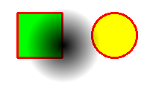
A Basic Custom Item
QRectF BasicItem::boundingRect() const
{
return QRectF(0, 0, 100, 100);
}
void BasicItem::paint(QPainter *painter,
const QStyleOptionGraphicsItem *option,
QWidget *widget)
{
painter->setPen(Qt::NoPen);
QRadialGradient gradient = radialGradient();
painter->setBrush(gradient);
painter->drawEllipse(boundingRect());
}
A partially
transparent
brush gives
a shading item
Notes:
An example implementation of a trivial custom item
The boundingRect method returns a constant size. Notice that the origin (0, 0), is expressed in the item's local coordinates. The item can still be moved.
The paintEvent then paints the content. It is not necessary to fill the entire bounding rect and transparency works as expected - i.e. whatever is behind bleeds through
Continues

Slide 33
Custom Items
The paint method is called when needed – not necessarily for all repaints
  Call update to trigger a repaint
The boundingRect must contain all of the item's graphics
  Do not forget that wide pens paint on both sides of the specified line
  When resizing, make sure to call prepareGeometryChange before you change the size of the item
Notes:
The paint method is only called when needed.
The graphics view and graphics scene will decide which paint methods to call.
The decision is based on the area needed to be painted and the items' bounding rectangles.
In order for this to work, you must include widths of pens in the bounding rect
You must also call prepareGeometryChange before changing the size of an item (i.e. the size of the bounding rectangle)

Slide 34
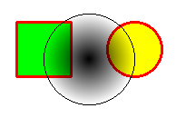
Interacting
The flag ItemIsMovable gives basic movability
The flag ItemIsSelectable makes it possible to select the item in question
  The item is automatically requested to repaint itself
item->setFlag(QGraphicsItem::ItemIsMovable, true);
item->setFlag(QGraphicsItem::ItemIsSelectable, true);
void BasicItem::paint(...)
{
if(isSelected())
painter->setPen(Qt::black);
else
painter->setPen(Qt::NoPen);
Notes:
Interacting with custom items is usually simple.
The movable flag works at once (given that you have not re-implemented the mousePressEvent, mouseMoveEvent or mouseReleaseEvent methods)
The selectable flags mean that the item can be selected. When selected, the isSelected method returns true.
To show when an item is selected, simply ensure to take isSelected into account
When the selection state is changed, a repaint is automatically triggered
Continues

Slide 35
Custom Interaction
The movability and item selection is implemented in the default mouse event handling methods
To gain full control, you can re-implement the event handling functions directly
  setAcceptHoverEvents enables hover events
  setAcceptTouchEvents enables touch events
  setAcceptedMouseButtons defines which buttons are handled by the item (default is to accept all buttons)
Notes:
Movement and selection of items are handled by default through the mousePress/Move/ReleaseEvent methods
To gain full control, you can override a number of event handling functions
In order to receive certain events you must enable them (or filter out events that you do not want).
For instance, the setAcceptHoverEvents and setAcceptTouchEvents enable or disable hover and touch events for a given item
The setAcceptedMouseButtons lets you declare which buttons that the item is interested in
Continues

Slide 36
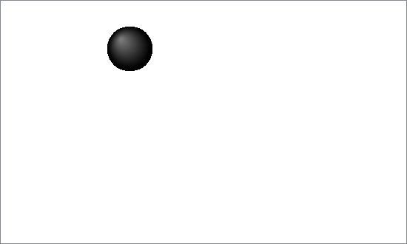
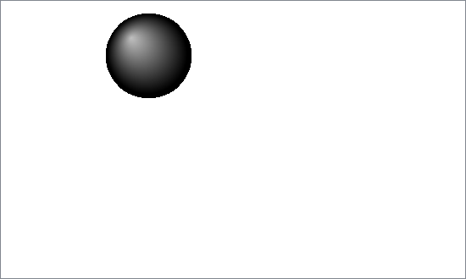
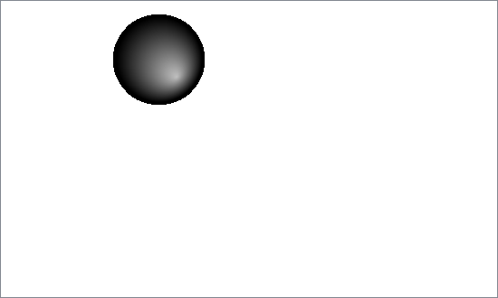
Interaction Example
An interactive custom item listening to hover events and mouse press events
  When hovered, the item expands
  When pressed, it changes appearance
inactive
hovered
pressed
Notes:
Let's look at an example of a custom item that listens to mouse pressed and hover event.
The basic behavior is that the item expands when it is being hovered. When it is pressed the appearance is changed.
The different states are shown to the right.
Continues

Slide 37
Interaction Example
Class Declaration
class InteractiveItem : public QGraphicsItem
{
public:
InteractiveItem(QGraphicsItem *parent=0);
QRectF boundingRect() const;
void paint(...);
protected:
void hoverEnterEvent(QGraphicsSceneHoverEvent*);
void hoverLeaveEvent(QGraphicsSceneHoverEvent*);
void mousePressEvent(QGraphicsSceneMouseEvent*);
void mouseReleaseEvent(QGraphicsSceneMouseEvent*);
protected:
bool m_pressed;
bool m_hovered;
};
Notes:
In the class declaration of the item, we find the usual suspects: a constructor, boundingRect and paint.
In addition, we find the protected, re-implemented, event handing methods: hoverEnterEvent, hoverLeaveEvent, mousePressEvent and mouseReleaseEvent.
The class also contains the two booleans m_pressed and m_hovered.
Continues

Slide 38
Interaction Example
Constructor
Initializing the item, making sure that both internal states are false
InteractiveItem::InteractiveItem(QGraphicsItem *parent) :
QGraphicsItem(parent),
m_pressed(false), m_hovered(false)
{
setAcceptHoverEvents(true);
}
Notes:
The constructor does what is expected – passes on the parent to the base class and initializes the private variables pressed and hovered.
It also sets up the item to accept hover events, otherwise the hoverEnterEvent and hoverLeaveEvent methods would never be called.
Continues

Slide 39
Interaction Example
Geometry and Painting
The bounding rectangle depends on the hovered state, while appearance depends on both hovered and pressed
QRectF InteractiveItem::boundingRect() const
{
if(m_hovered)
return QRectF(-50, -50, 101, 101);
else
return QRectF(-30, -30, 61, 61);
}
void InteractiveItem::paint(QPainter *painter,
const QStyleOptionGraphicsItem *option, QWidget *widget)
{
QRadialGradient gradient;
if(m_hovered)
... // Setup gradient
if(m_pressed)
... // Setup gradient
... // Paint here
}
Notes:
The bounding rectangle size depends on the hovered state, represented by the m_hovered boolean.
In the paint event, both the hovered and pressed states are taken into account when setting up the gradient.
Continues

Slide 40
Interaction Example
Mouse Events
The mouse events only affect the appearance
  State change is followed by call to update
void InteractiveItem::mousePressEvent(QGraphicsSceneMouseEvent*)
{
m_pressed = true;
update();
}
void InteractiveItem::mouseReleaseEvent(QGraphicsSceneMouseEvent*)
{
m_pressed = false;
update();
}
Notes:
In the mouse press and release event handlers, the m_pressed state variable is updated.
As this change affects the appearance of the item, the update method must be called as well. This triggers a repaint of the item (if it is visible).
Continues

Slide 41
Interaction Example
Hover Events
The hover events affect the bounding rectangle
  First call prepareGeometryChange, then alter state
void InteractiveItem::hoverEnterEvent(QGraphicsSceneHoverEvent*)
{
if(!m_hovered)
{
prepareGeometryChange();
m_hovered = true;
}
}
void InteractiveItem::hoverLeaveEvent(QGraphicsSceneHoverEvent*)
{
if(m_hovered)
{
prepareGeometryChange();
m_hovered = false;
}
}
Notes:
The hover events not only changes the appearance of the item, but also its size.
This means that prepareGeometryChange must be called before the state is changed. It is important that boundaryRect returns the old rectangle while prepareGeometryChange is being called, and is changed afterwards.
Calling prepareGeometryChange triggers a call to update if the geometry actually does change.

Slide 42
QGraphicsObject
The QGraphicsItem class is not derived from QObject – this means that
  Items cannot have properties
  Items cannot have slots
  Items cannot emit signals
The QGraphicsObject class is a QObject derived QGraphicsItem class
Notes:
The QGraphicsItem class that we have used up until now is not a QObject
The implications from this is that items do not have properties – they can still have getter and setter methods, but nothing is exposed through the Qt property system
Another drawback is that they cannot have signals nor slots
The choice to implement graphics items this way was to shrink the footprint of each item. As the graphics view classes are optimized for handing tens of thousands of items, each byte of overhead can be costly – especially in an embedded setting
When you need QObject features in a graphics view item, you can use the QGraphicsObject class as the base for your items. It is a QObject-derived class which also includes the QGraphicsItem class.
Continues

Slide 43
QGraphicsObject
When sub-classing QGraphicsObject, there are some things to keep in mind
  Relationships between items are explored using parentItem and childItems
  Relationships between QObjects are explored using parentObject and parentWidget
  Use QGraphicsItem's features for modifying ownership trees, e.g. setParentItem
Notes:
When sub-classing the QGraphicsObject class, it is important to recognize that the parent-child-hierarchy of items is separate from the parent-child-hierarchy of object.
To access items – use parentItem and childItems
To access objects, use parentObject and parentWidget
When modifying ownership tree, stick to using the QGraphicsItem's features
Using QGraphicsObjects in ownership trees can be complex, so try to avoid mixing the items' and objects' ownership system. Instead, stick to the items' mechanisms and use the QObject aspect to gain access to other features (such as signals and slots)
Continues

Slide 44
Interactive
QGraphicsObject
Start from the InteractiveItem class
  Change the name to InteractiveObject
  Change the base class to QGraphicsObject
  In the mouse release event, emit a signal if the mouse button is released while over the circle
The parent is
still an item
class InteractiveObject : public QGraphicsObject
{
Q_OBJECT
public:
explicit InteractiveObject(QGraphicsItem *parent = 0);
QPointF delta = boundingRect().center()-ev->pos();
qreal radius = boundingRect().width()/2.0;
if(delta.x()*delta.x()+delta.y()*delta.y() <= radius*radius)
emit clicked();
Notes:
One example of when the QGraphicsObject base is interesting is when you want to emit signals.
Taking the InteractiveItem class from earlier, we can simply change the base class to QGraphicsObject. You must do this in your constructor implementation as well, but the compiler will tell if you fail to do so.
In the mouse release event, you can then emit a signal as you do from any QObject

Slide 45
Widgets in a scene
It is possible to place QWidgets in a graphics view scene
  The widgets are managed by a QGraphicsProxyWidget
  Performance is not very good
  Complex widgets are not always rendered correctly
  Use for quick hacks or when migrating code
QWidget *myWidget = new QPushButton(tr("Qt"));
QGraphicsProxyWidget *proxyWidget =
scene->addWidget(myWidget);
Notes:
As a way to transition from old user interfaces based only on widgets, Qt provides the means to place widgets in a scene.
This is not recommended as the performance is not very good and the rendering sometimes breaks if the widgets does unexpected things.
Still, this can be very useful when prototyping and you just need that button to trigger a signal, so you should know about it.

Slide 46
Rendering Hints
It is possible to tune the QGraphicsView to render the scene more quickly or in greater detail
  renderHints – a set of flags controlling rendering
    Antialias – enables anti-aliasing
    SmoothPixmapTransform – enables smoother pixmap transformations
Notes:
The performance of a graphics view depends on the rendering quality. The quality requirements depend much on the scenario, so this must be tuned to the needs of your application.
Each graphics view has a renderHints property that consists of a set of flags that control the rendering.
Basically, what you control where anti-aliasing is applied, if at all, and how pixmap transforms are handled.
Continues

Slide 47
Caching
The caching of individual QGraphicsItems can greatly affect performance
Caching is tuned using QGraphicsItem::setCacheMode
  ItemCoordinateCache
    Caches the item in its local coordinate system
    Can reduce rendering quality
    Call setCacheMode again to resample the item
  DeviceCoordinateCache
    Perfect for items that do not apply other transformations than translation
Notes:
It is also possible to tune the performance at item level.
Items can be cached by the scene to avoid unnecessary calls to the paint method.
What you can tune is if the items are cached in their local coordinate system or in the device coordinate system.
When setting the mode to item coordinates, the rendering quality can be reduced slightly when transformed. For instance, rotation will be made of the rendered item.
You can remedy this by calling setCacheMode again to re-sample the item after each transformation, but that will cost performance
Using device coordinates is perfect for items that are only translated – the items are stored in the right coordinate system and resolution – needing only to be copied onto the screen
Continues

Slide 48
Enabling Hardware Acceleration
To use OpenGL for rendering the scene, change the viewport widget of the view
The renderHint flag HighQualityAntialiasing can be set to enable fragment programs and off-screen rendering for antialiasing when using OpenGL
QGraphicsView *view = new QGraphicsView();
view->setViewport(new QGLWidget);
Notes:
The final potential performance improvement is to let the graphics view render to an OpenGL accelerated widget
By setting the viewport of a graphics view object to use a QGLWidget, this is achieved.
By setting the rendering hint flags of the graphics view to to enable HighQualityAntialiasing, you enable Qt to use fragment shaders and off-screen rendering to perform high quality antialias on OpenGL surfaces

Slide 49
Enabling Hardware Acceleration
To use OpenGL for rendering the scene, change the viewport widget of the view
The renderHint flag HighQualityAntialiasing can be set to enable fragment programs and off-screen rendering for antialiasing when using OpenGL
QGraphicsView *view = new QGraphicsView();
view->setViewport(new QGLWidget);
Notes:
The final potential performance improvement is to let the graphics view render to an OpenGL accelerated widget
By setting the viewport of a graphics view object to use a QGLWidget, this is achieved.
By setting the rendering hint flags of the graphics view to to enable HighQualityAntialiasing, you enable Qt to use fragment shaders and off-screen rendering to perform high quality antialias on OpenGL surfaces

